Slide 1


Ways of using a computer
Question: What is the probability of getting at least one pair in a hand of five cards drawn from a standard deck of 52 cards?
Calculator: 0.49
Enumerator: 0.49
Simulator: 0.51 (200), 0.48 (2000), 0.49 (20000)

Slide 2
Ways of using a computer
For statistical purposes, Economists will often use a computer as a simulator (to do Monte Carlo simulations).
But for solving theoretical models, economists have conventionally used a computer primarily as a calculator.
However, many if not most realistic economic models are “intractable” and cannot be solved by conventional methods

Slide 3
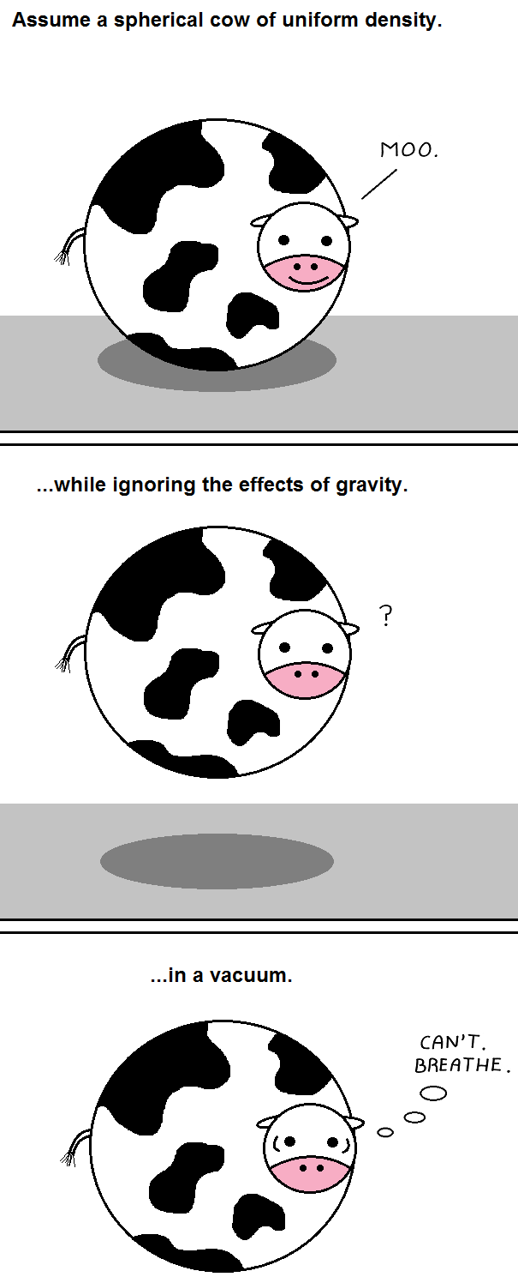
Unrealistic but common assumptions
Unrealistic utility functions.
Unrealistic optimizations.
Unrealistic information and expectations frameworks.
Unrealistic levels of homogeneity and unhelpful degree of aggregation.
Steady-states, fixed points, equilibriums all of which may only be applicable in the ‘long run.’

Slide 4
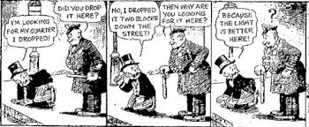
My objections
Why Assume When Simulations Possible
Economy Greater than Sum of Parts

Slide 5
Emergent Phenomena, Complex Systems, Complex Adaptive Systems
Irreducibility – whole has features not apparent in parts; e.g., temperature and phase in physics, conscious thought from neurons, efficient markets from individual transactions. We need to know about the system and interactions of parts
A complex system is a system composed of many components which may interact with each other. Complex systems are systems whose behavior is intrinsically difficult to model due to the dependencies, competitions, relationships, or other types of interactions between their parts or between a given system and its environment. (Wikipedia)
Complex Adaptive Systems are complex in that they are dynamic networks of interactions, and their relationships are not aggregations of the individual static entities, i.e., the behavior of the ensemble is not predicted by the behavior of the components. They are adaptive in that the individual and collective behavior mutate and self-organize corresponding to the change-initiating micro-event or collection of events. (Wikipedia)

Slide 6
Agent-Based Computational Economics
Use the computer to create simulations of artificial economies or societies
In each simulation there are many computer-generated individuals (called “agents”) who are programmed to behave like human beings (or other economic entities) in the real economy.
The consequences of the actions and interactions of these agents are then studied to analyze the economic issue.
Formally, computational study of economic processes modeled as dynamic systems of interacting agents

Slide 7
Agent-Based Computational Economics
ABM has a long history in natural sciences – from ecology to astrophysics, simulation-based studies are commonplace
ACE rapidly gaining popularity, especially since 2008.
ACE is particularly suitable to model complex systems where agents’ interactions combine to produce unexpected outcomes
ACE models exist in the frontiers of Macroeconomics, Urban Economics, Finance, Industrial Organization, etc.

Slide 8
ACE: Strengths
Study emergent behavior (traffic jams, recessions, polarization, etc.)
Study dynamic behavior.
Study complex models with multiple equilibria.
Study network-based models.
Study realistic models in terms of assumptions related to human behavior and its heterogeneity

Slide 9
ACE: Weaknesses
More suitable for theoretical models that explain phenomena rather than empirical models that estimate correlations or produce numerical forecasts. (exceptions e.g. EURACE, Bank of England Housing Model)
Too much modelling freedom?
Curse of dimensionality
Profusion of results

Slide 10

Example 1: Segregation in Cities
Thomas Schelling, 1971 (Nobel Prize, 2005) pioneered ACE
Even a small degree of racial preference could lead to almost complete racial segregation in a city.
Analytical solution does not capture tipping points, dynamics, and characteristics of common outcomes.
A brief demonstration

